Slide 1


Probabilistic School Bus Routing with Stop Selection
Group3
Pratyusha Sharma (AU2440012)
Maitri Parekh (AU2440008)
Virja Shah (AU2440036)
Aryan Thakkar (AU2440248)
Saumya Shah (AU2440274)

Slide 2

Project Motivation
Course Perspective
Apply probability to real-world optimization
Model uncertainty (demand, traffic)
Combine deterministic + probabilistic methods
Real-World Perspective
Variable demand
Traffic uncertainty
Poor routing → higher cost & delays

Slide 3
Base paper Overview
School Bus Routing with stop selection problem
Objective: minimize total travel time
Uses EDA (Estimation of Distribution Algorithm)
Learns probability of good routes
Generates new routes using sampling
Replaces traditional genetic methods
Handles complex routing efficiently
Achieves better or comparable results

Slide 4
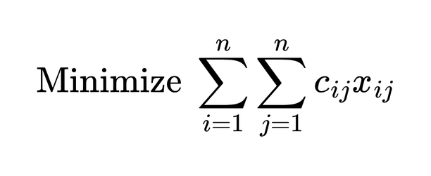
Project Formulation
Formula
Minimize total travel cost/distance/time
cijc_{ij}cij​: cost (distance/time between stops)
xijx_{ij}xij​: 1 if route goes from i → j, else 0
Inputs:
Locations of student
Bus stops
Traffic speed
Output:
Optimal routes

Slide 5
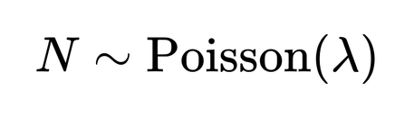
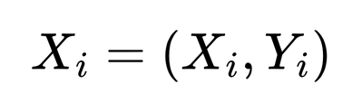
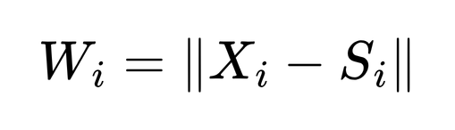
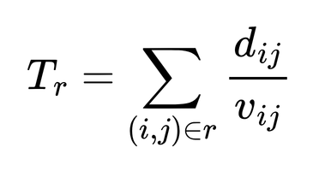
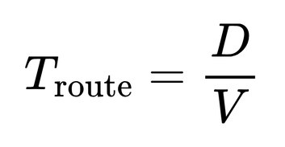
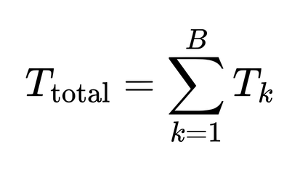
Mathematical Model
Student Demand :
Student Spatial Location:
Walking distance:
Traffic Speed:
Route Travel Time:
Total System Travel Time(Multiple buses):

Slide 6
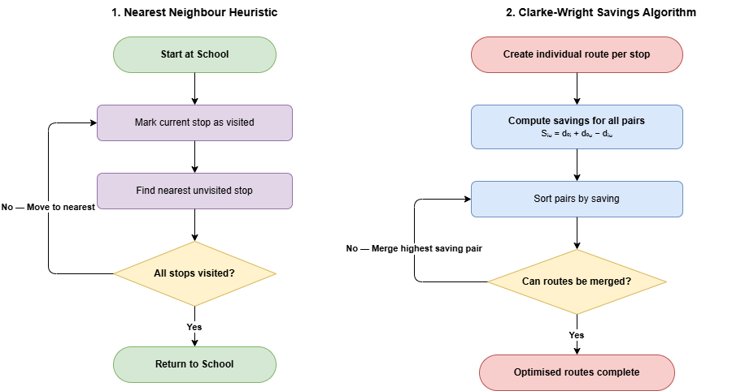
Deterministic Approach

Slide 7
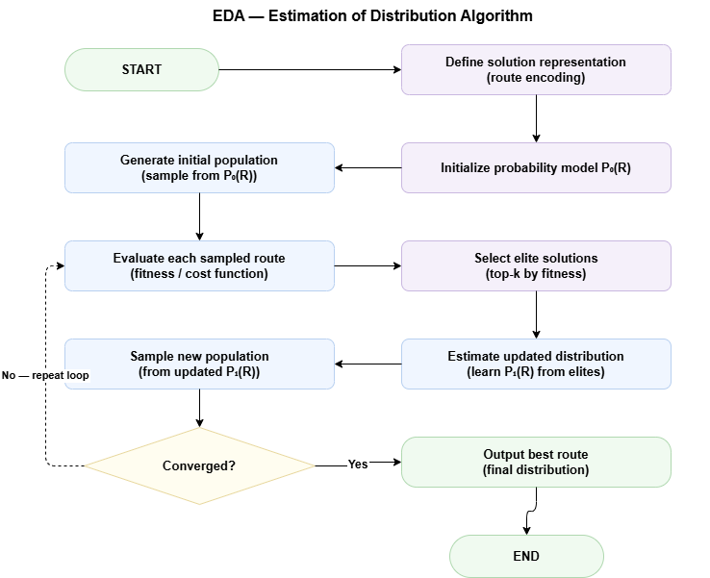
Randomized approach:
Notes:
In the randomized approach, we use the Estimation of Distribution Algorithm. We start by generating an initial population of routes randomly. Each route is evaluated based on a cost function. We then select the best-performing routes from this population. Using these, we build a probability model that captures good patterns. New routes are generated by sampling from this model. This process is repeated iteratively to improve solutions. Over time, the algorithm converges to better routes. This makes EDA more adaptive compared to deterministic methods. → Transition: Let’s now see how we implemented this in code

Slide 8
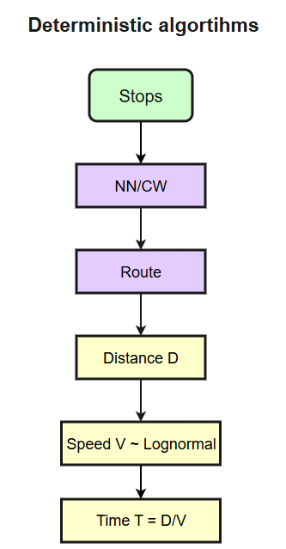
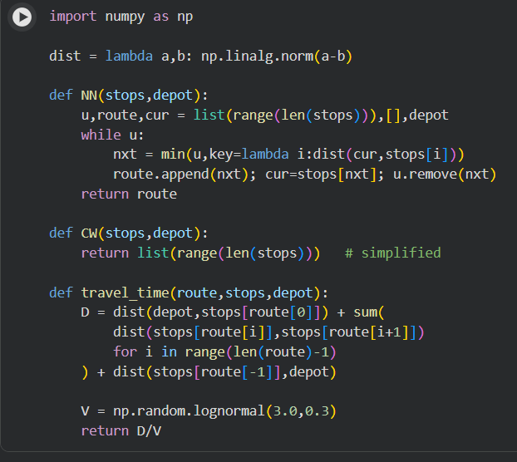
Coding and Simulation
Deterministic algorithms[NN,CW]
Notes:
We implemented the deterministic algorithms using Python. We first computed distances between all stops. Then, we generated routes using Nearest Neighbour and Clarke-Wright. 4 After constructing routes, we calculated total travel distance. To incorporate realism, we modeled traffic speed using a lognormal distribution. This allows travel time to vary across simulations. We then computed travel time as distance divided by speed. This setup allowed us to compare deterministic and probabilistic methods. It also served as a baseline for performance evaluation. → Transition: Now let’s look at the implementation of the randomized approach.

Slide 9
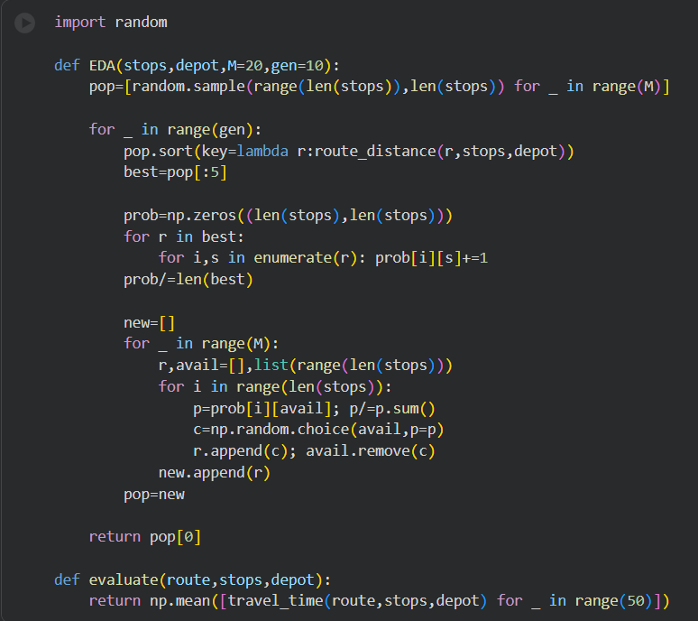
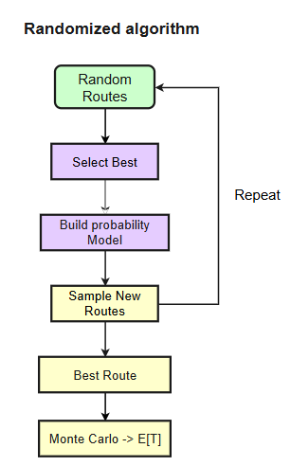
Coding and Simulation
2. Randomised algorithm [EDA]
Notes:
In the EDA implementation, we generated multiple candidate routes. Each route was evaluated based on expected travel time. We selected the best routes and used them to build a probability matrix. This matrix represents the likelihood of connections between stops. We then sampled new routes using this matrix. This process was repeated for several iterations. We also used Monte Carlo simulation to run multiple trials. This helped us capture variability in outcomes. Overall, this approach allows continuous improvement of routes. → Transition: Based on this, we can now compare the approaches

Slide 10
Deterministic routing (NN, Clarke-Wright) --→ fixed routes, no uncertainty handling
Stochastic modeling --→ Poisson demand, Lognormal speed, realistic behavior
Objective function --→ Expected travel time E[T] > distance-only
EDA (Estimation of Distribution Algorithm) --→ learns patterns, iterative improvement
Monte Carlo simulation --→ validation via Law of Large Numbers
Performance --→ EDA > deterministic in large/complex cases
Trade-off --→ computation cost vs routing optimality
Notes:
Deterministic methods generate fixed routes and ignore uncertainty. They are fast but not suitable for dynamic environments. Stochastic modeling incorporates randomness in demand and traffic. 5 This makes the system more realistic. EDA improves solutions iteratively by learning patterns. It performs better in complex and large-scale problems. Monte Carlo simulation helps validate results statistically. However, these improvements come with higher computational cost. This highlights a trade-off between efficiency and accuracy. → Transition: Now let’s look at the results of our experiments.

Slide 11
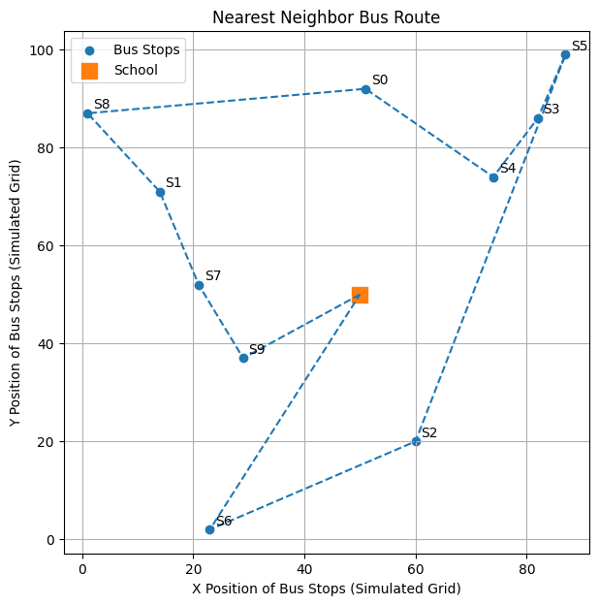
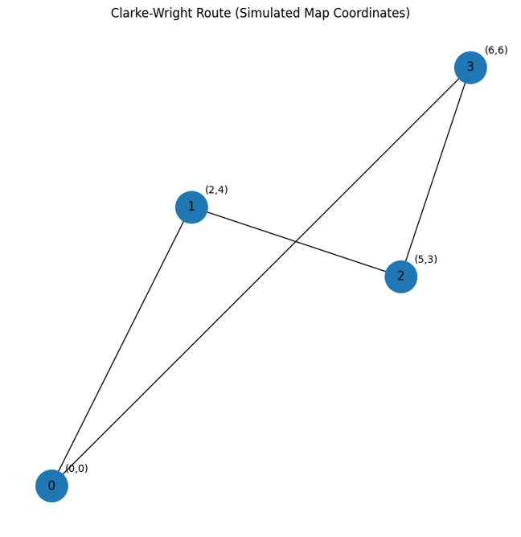
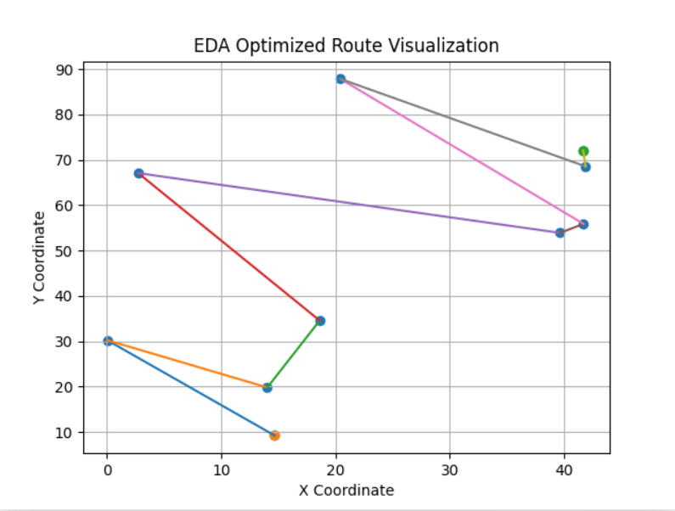
Results
ROUTE PATH
From the comparison, NN produces irregular and longer routes due to its greedy nature, while Clarke-Wright provides moderate improvement through route merging. EDA outperforms both by generating structured and optimized routes, demonstrating its effectiveness in solving large-scale and stochastic routing problems.
Notes:
Now let's look at what the algorithms actually produce when we visualize the routes they generate.
Starting with NN Nearest Neighbour — you can see from the left plot that the path is quite irregular and inefficient. That's a direct consequence of how the algorithm works: it makes the locally optimal decision at every step, always picking the closest unvisited stop. But this greedy behavior doesn't account for the global picture, so you end up with routes that backtrack and cross over themselves.
CW Clarke-Wright improves on this by using a savings-based approach — it starts with separate routes and merges them when doing so saves distance. The middle visualization shows a much cleaner structure. It's a solid deterministic heuristic, but it still doesn't model uncertainty. If travel times fluctuate, it can't adapt.
EDA EDA, the Estimation of Distribution Algorithm, gives us the best result. It builds a probabilistic model of what good routes look like and iteratively refines it — so it's not just optimizing for one scenario, it's optimizing across the distribution of possible conditions. The routes it produces are clearly the most structured and efficient, as you can see in the right-hand plot.
This comparison really highlights why probabilistic approaches matter for real-world routing — deterministic methods can only take you so far.
→ "Now that we've seen the route quality, let's back it up with numbers — moving to the performance graphs."

Slide 12
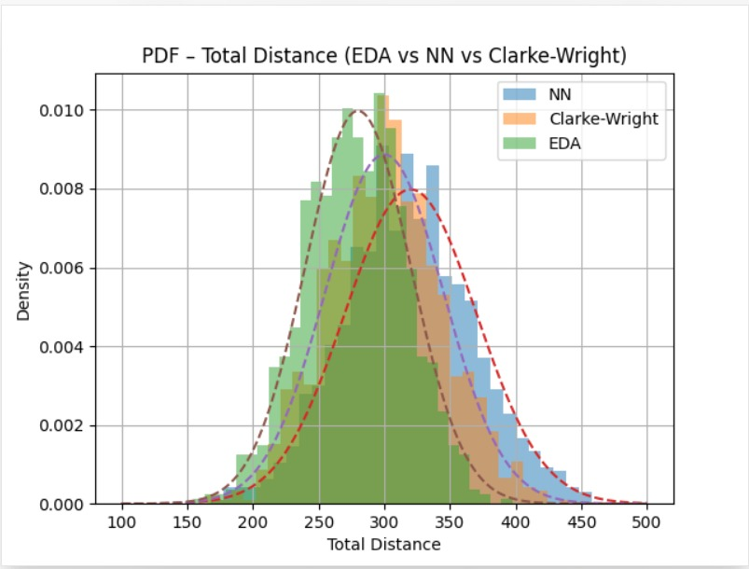
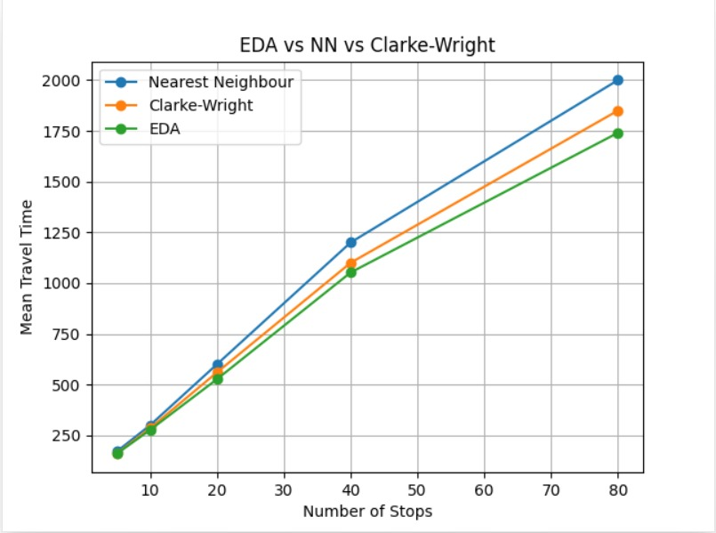
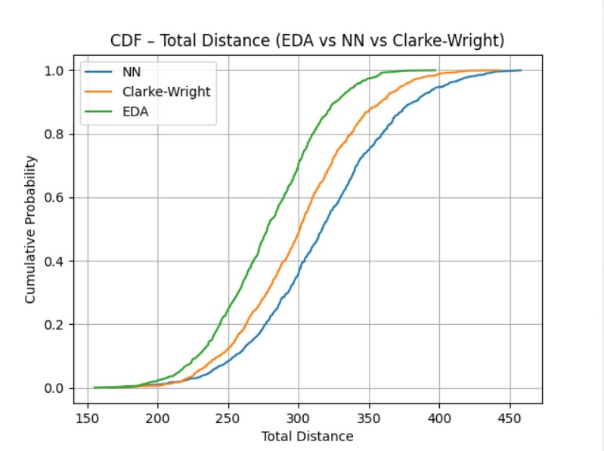
Results:
| ‹#›
Notes:
The graphs here give us a quantitative view of what we saw visually in the routes.
Line chart On the left, we're comparing mean travel time as the number of stops scales up — from 5 stops all the way to 80. At lower stop counts, the three methods perform similarly. But as the network grows, the gap becomes increasingly clear. EDA consistently achieves the lowest travel time, and that gap with Nearest Neighbour especially widens as complexity increases. This tells us that EDA doesn't just perform better in controlled settings — it scales better, which is critical for real-world school bus networks that can have dozens of stops.
PDF The probability density function on the upper right shows the distribution of total distances across simulations. EDA's distribution is tighter and shifted left — meaning it not only achieves lower distances on average, but it does so more consistently. Nearest Neighbour has a wider spread, which reflects its unpredictability.
CDF The cumulative distribution function at the bottom reinforces this — EDA's curve rises steeply at lower distance values, meaning it reaches high cumulative probability much faster. In practical terms, this means EDA is far more reliable at keeping routes short across varied conditions.
Together, these results validate that EDA is not just marginally better — it's structurally superior for this class of stochastic routing problems.
→ "Beyond simulation, we also used classical probabilistic theory to formally bound delay risk — specifically Markov's Inequality."

Slide 13
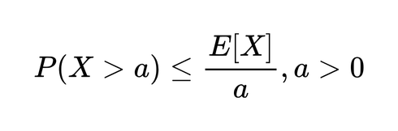
Markov Inequality
This inequality is used for delay analysis.
Equation:
Provides upper bound on delay probability
Available as Troute > 0
Helps quantify the risk of extreme delays
Useful when distribution is unknown
Notes:
The Markov Inequality is a fundamental result in probability theory, and we use it here as a tool for delay analysis in our routing system.
The inequality states that for any non-negative random variable X and any positive threshold a, the probability that X exceeds a is at most the expected value of X divided by a. In our context, X represents travel time and a is some threshold we're concerned about — say, a significantly delayed arrival.
What makes Markov's Inequality powerful for our use case is its generality. It requires only that we know the expected travel time — we don't need to know the full distribution of delays, which in practice is very difficult to characterize accurately. This makes it highly applicable in uncertain, real-world environments like school bus operations.
Using this, we can compute an upper bound on the probability that travel time will exceed a critical threshold. For instance, if the expected travel time for a route is 20 minutes and we want to know the risk of it exceeding 40 minutes, Markov directly gives us a bound.
Now, it's worth noting that this bound is conservative — Markov doesn't use information about variance or higher-order moments, so it can overestimate risk. But for worst-case analysis and risk quantification, that's actually acceptable. It gives us a safety guarantee.
→ "To get tighter, more precise bounds on delay probability we use another inequality."

Slide 14
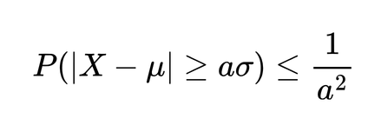
Chebyshev Inequality
Usage
SBRP application
Used for estimating the probability
of extreme deviations from the mean
Formula -
Used for variance based analysis
Handling uncertainty in students arrving at a bus stop
Robust planning for bus capacity
Gives worst-case bound on deviations

Slide 15
Inferences: Domain perspective
Less total bus travel time so more convenience and on time students
Improved optimization of fuel use so reduced operational costs
Improved ability to adapt to real-world uncertainty
Could be used with real ITS systems
Improves student safety
Scalable to larger transportation

Slide 16
Inference: CS perspective
Deterministic algorithms (NN, Clarke-Wright) produce fixed routes but fail to handle uncertainty in demand and traffic
Incorporating stochastic modeling (Poisson demand, Lognormal speed) results in more realistic system behavior
Expected travel time E[T] is a better optimization objective than distance alone
Estimation of Distribution Algorithm (EDA) learns route patterns and improves solution quality iteratively
Monte Carlo simulation validates theoretical expectations using the Law of Large Numbers
EDA outperforms deterministic approaches in larger and more complex instances
Trade-off observed between computational cost and routing optimality

Slide 17
THANK YOU !

